Slide 1
Different ways of Sharing Information in Social Networks
Project Advisor
- Dr. SHELLEY ZHANG
By:
Sumukhi Kappa

Slide 2
INTRODUCTION
Social networks are the new standards of community interactions.
These are used on daily basis for many tasks like communication, education, business marketing, searching for jobs, sharing information etc.
There are many social networking sites that not just provide a platform for people to communicate; it also allow us to share their interests, opinions or ideas with their connections.
Communicating or sharing information through messages would costs us personal time, communication and computational resources.

Slide 3
MOTIVATION
An increase in amount of messages sent, reduces the attention of a receiver or there can be any indifference in the message.
To ensure the capability of sending message to its target users of interest, it is important to send the right message to the right person who is interested in that message.
Decision-making regarding which message should be shared with whom and in a way that doesn’t reduce the receiver’s attention is of utmost importance.
To achieve this, we analyze different ways of sharing information.

Slide 4
APPROACH
The main objects in this approach are messages and nodes.
Each messages has its own category list and relevance score to which it belongs.
Ex- { Sports,0.9}
Each node has its own Interest Profile.
Ex- "0":{"reebok":{"interestFactor":"2", "score":"0.3"},"nike":{"interestFactor":"2", "score":"0.2"},"adidas":{"interestFactor":"5", "score":"0.8"},"home decor":{"interestFactor":"4", "score":"1"},"tools":{"interestFactor":"5", "score":"0.4"}}
This study assumes that information relevance of a message and Interest profile of a node are available.

Slide 5
Different Strategies for Sharing Information
Three Strategies
- Average Interest and Relevance
- Combined Interest and Relevance
- Moderate Interest and Relevance

Slide 6
STRATEGY – 1 Average Interest and Relevance
MESSAGE -
Node is determined to be interested and will send the message when
I_{a} >= 3 && R_{a} >= 0.5
POST -
Node is determined to be interested and will send the message when
Avg I_{a} >= 2 && Avg R_{a} >= 0.2
I_{a} is average interest factor of all the categories of a node’s interest list.
R_{a} is average relevance score for all the categories of a node’s interest list which also belongs to message category list.

Slide 7
Example
Example for Posting the message :
Categories list CL_{i} = {(“sports”, 0.1),(“nike”,0.2),(“reebok”,0.3)}
The application does not send the message to any node as the average relevance of CLi is less than 0.3 it would rather post.
Example for forwarding the message:
Categories list CL_{i} = {(“sports”, 0.8),(“nike”,0.1),(“reebok”,0.3)}
The application sends the message to sample node as the average relevance of CL_{i} is greater than 0.3 and the average score of sports, reebok, nike is greater than 3.
"0":{"sports":{"interestFactor":"4", "score":"0.3"},"reebok":{"interestFactor":"4", "score":"0.3"},"nike":{"interestFactor":"2", "score":"0.2"},"adidas":{"interestFactor":"5", "score":"0.8"},"home decor":{"interestFactor":"4", "score":"1"},"tools":{"interestFactor":"5", "score":"0.4"},"toys":{"interestFactor":"4", "score":"0.2"},"clothes":{"interestFactor":"4", "score":"0.6"},"cookware":{"interestFactor":"1", "score":"0.6"},"appliances":{"interestFactor":"5",

Slide 8
STRATEGY – 2 Combined Interest and Relevance
MESSAGE
For any common category x in both the message’s category list and also in the node’s interest list, the combined relative average of the interest factor and the relevance of category x is Greater than or equal to 50%
(fn_{x}% + ri_{x}%)/2>= 50%
POST
For any common category x in both the message’s category list and also in the node’s interest list, the combined relative average of the interest factor and the relevance of category x is Greater than or equal to 20%
avg (fn_{x}% + ri_{x}%)/2>= 20%

Slide 9
EXAMPLE
Example for posting the message :
Categories list CL_{i} = {(“sports”, 0.5)}
"0":{"sports":{"interestFactor":"2", "score":"0.3"},"reebok":{"interestFactor":"0", "score":"0.3"},"nike":{"interestFactor":"0", "score":"0.2"},"adidas":{"interestFactor":"5", "score":"0.8"},"home decor":{"interestFactor":"4", "score":"1"},"tools":{"interestFactor":"5", "score":"0.4"},"toys":{"interestFactor":"4", "score":"0.2”}
"0":{"sports":{"interestFactor":“1", "score":"0.5"},"reebok":{"interestFactor":"0", "score":"0.3"},"nike":{"interestFactor":"0", "score":"0.2"},"adidas":{"interestFactor":"5", "score":"0.8"},"home decor":{"interestFactor":"4", "score":"1"},"tools":{"interestFactor":"5", "score":"0.4"},"toys":{"interestFactor":"4", "score":"0.2”}
"0":{"sports":{"interestFactor":"2", "score":"0.5"},"reebok":{"interestFactor":"0", "score":"0.3"},"nike":{"interestFactor":"0", "score":"0.2"},"adidas":{"interestFactor":"5", "score":"0.8"},"home decor":{"interestFactor":"4", "score":"1"},"tools":{"interestFactor":"5", "score":"0.4"},"toys":{"interestFactor":"4", "score":"0.2”}
The application will post the message instead of sending the message to the node below as the requirement is met
fnx% = 2/5 => 40% fnx% = 1/5 => 20%
rix% = 0.5/1 => 50% rix% = 0.5/1 => 50%
(fnx% + rix%)/2 = (40+50)/2 = 45% (fnx% + rix%)/2 = (20+50)/2 = 35%
Avg (fnx% + rix%)/2 = (35+45)/2 = 40% which is less than the required 50%

Slide 10
EXAMPLE
Example for forwarding the message :
Categories list CL_{i} = {(“sports”, 0.6)}
"0":{"sports":{"interestFactor":“3", "score":"0.5"},"reebok":{"interestFactor":"0", "score":"0.3"},"nike":{"interestFactor":"0", "score":"0.2"},"adidas":{"interestFactor":"5", "score":"0.8"},"home decor":{"interestFactor":"4", "score":"1"},"tools":{"interestFactor":"5", "score":"0.4"},"toys":{"interestFactor":"4", "score":"0.2"},"clothes":{"interestFactor":"4", "score":"0.6"},"cookware":{"interestFactor":"1", "score":"0.6"},"appliances":{"interestFactor":"5", "score":"1"}}
"0":{"sports":{"interestFactor":“4", "score":"0.7"},"reebok":{"interestFactor":"0", "score":"0.3"},"nike":{"interestFactor":"0", "score":"0.2"},"adidas":{"interestFactor":"5", "score":"0.8"},"home decor":{"interestFactor":"4", "score":"1"},"tools":{"interestFactor":"5", "score":"0.4"},"toys":{"interestFactor":"4", "score":"0.2”}
"0":{"sports":{"interestFactor":“3", "score":"0.5"},"reebok":{"interestFactor":"0", "score":"0.3"},"nike":{"interestFactor":"0", "score":"0.2"},"adidas":{"interestFactor":"5", "score":"0.8"},"home decor":{"interestFactor":"4", "score":"1"},"tools":{"interestFactor":"5", "score":"0.4"},"toys":{"interestFactor":"4", "score":"0.2”}
The application will post the message instead of sending the message to the node below as the requirement is met
fnx% = 3/5 =>60% fnx% = 4/5 => 80%
rix% = 0.6/1 => 60% rix% = 0.7/1 => 70%
(fnx% + rix%)/2 = (60+60)/2 = 60% (fnx% + rix%)/2 = (70+80)/2 = 75%
Avg (fnx% + rix%)/2 = (75+65)/2 = 68% which is more than the required 50%

Slide 11
STRATEGY -3 Moderate Interest and Relevance
MESSAGE
Send the message to the node if for any common category x in both the message’s category list and also in the node’s interest list, the node’s interest factor for x is greater than or equal to 3 or the message relevance for x is greater than or equal to 0.7
ci_{x} ∈ FL_{i} && fn_{x} >= 3 || ri_{x} >= 0.7
POST
Send the message to the node if for any common category x in both the message’s category list and also in the node’s interest list, the node’s interest factor for x is greater than or equal to 2 or the message relevance for x is greater than or equal to 0.5
ci_{x} ∈ FL_{i} && fn_{x} >= 2 || ri_{x} >= 0.5

Slide 12
EXAMPLE
Example for posting the message
Categories list CL_{i} = {(“sports”, 0.6)}
The application does not send the message to the node below as the relevance is greater than or equal to 0.5
"0":{"sports":{"interestFactor":"4", "score":"0.3"},"reebok":{"interestFactor":"0", "score":"0.3"},"nike":{"interestFactor":"0", "score":"0.2"},"adidas":{"interestFactor":"5", "score":"0.8"},"home decor":{"interestFactor":"4", "score":"1"},"tools":{"interestFactor":"5", "score":"0.4"},"toys":{"interestFactor":"4", "score":"0.2"},"clothes":{"interestFactor":"4", "score":"0.6"},"cookware":{"interestFactor":"1", "score":"0.6"},"appliances":{"interestFactor":"5", "score":"1"}}
Example for sending the message
Categories list CL_{i} = {(“sports”, 0.8)}
The application does send the message to the node below as the fn_{x} = 4 which is greater the required 3 and the relevance ri_{x} = 0.8 which is greater than 0.7
"0":{"sports":{"interestFactor":"4", "score":"0.3"},"reebok":{"interestFactor":"0", "score":"0.3"},"nike":{"interestFactor":"0", "score":"0.2"},"adidas":{"interestFactor":"5", "score":"0.8"},"home decor":{"interestFactor":"4", "score":"1"},"tools":{"interestFactor":"5", "score":"0.4"},"toys":{"interestFactor":"4", "score":"0.2"},"clothes":{"interestFactor":"4", "score":"0.6"},"cookware":{"interestFactor":"1", "score":"0.6"},"appliances":{"interestFactor":"5", "score":"1"}}
Example for posting the message :

Slide 13
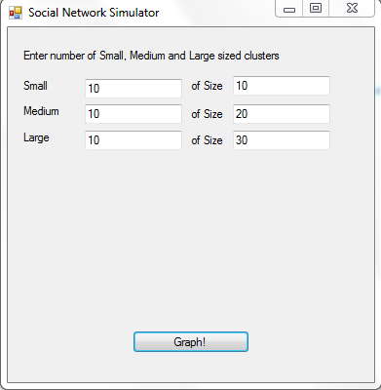
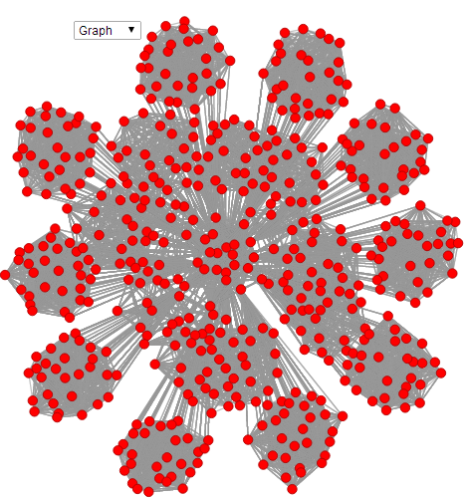
Interface
Form -1

Slide 14
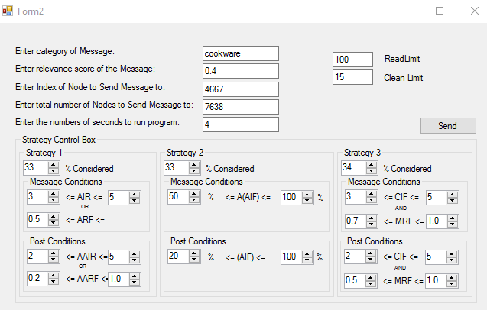
Interface
Form -2

Slide 15
EXPERIMENTS
To analyze how these strategies work on different network structures and we evaluate based on 3 different ratios for each network.
We have different messages in each network and the total number of messages are 15% of total number of nodes in a network.
Time is measured in number of time steps and the total number of time steps for each network is 40% of total number of nodes.
Message relevance profile is generated randomly with a list of categories and their relevance.
The dataset contains different nodes with their profile, while creating a network an ID is generated for each node and the nodes profile corresponding to that ID is taken from the dataset.

Slide 16
NETWORK STRUCTURES for the Experiments
large
small
medium
582 nodes
233 time steps
large
medium
small
2000 nodes
Total messages - 89
800 time steps
Read limit - 30
Total messages - 303
Read limit - 80
Network - 1
Network - 2
large
medium
small
3150 nodes
1300 time steps
Total messages - 475
Read limit - 100
Network - 3

Slide 17
Evaluation Criteria
To evaluate these results we have three different Ratios for each network.
Interest Ratio
Reachability Ratio
Appreciation Ratio
Interest Ratio:
[sum of all nodes] Interested & Received messages/ Total messages received.
Reachability Ratio:
[sum of all messages] Interested and received nodes/ interested nodes
These two ratios are calculated differently for high, moderate and low interested nodes.
If the interest factor equals to 5 then it is a Highly Interested node.
If the interest factor is between 3 and 4 then it is a Moderate interested node.
If the interest factor is less than 3 then it is a low interested node.

Slide 18
Evaluation Criteria
Appreciation Ratio:
[sum of all nodes] Messages appreciated/ Messages forwarded
In this, for each network nodes are classified based on appreciation Ratio in 3 ways.
Message is appreciated when the interest factor is greater than or equal to 3 and message relevance is greater than or equal to nodes relevance.
Post is appreciated when the interest factor of a message is greater than or equal to 3 and message relevance is greater than or equal to nodes relevance and message in the post board is read.

Slide 19
RESULTS- NETWORK -1 Message

Slide 20
RESULTS- NETWORK 1
Reachability Ratio Of Messages
Reachability Ratio Of Posts

Slide 21
RESULTS- NETWORK 1
Appreciation Ratio of Messages
Appreciation Ratio of Posts

Slide 22
RESULTS- NETWORK 1
Message Node Ratio
Post Node Ratio

Slide 23
Network – 1 (Combined Results)
Interest Ratio and Reachability Ratio of both Message and Post Combined
Appreciation Ratio and Message Post Node Ratio of both Message and Post Combined

Slide 24
RESULTS - NETWORK 2
Interest Ratio Of Messages
Interest Ratio Of Posts

Slide 25
RESULTS - NETWORK 2
Reachability Ratio Of Messages
Reachability Ratio Of Posts

Slide 26
RESULTS - NETWORK 2
Appreciation Ratio of Messages
Appreciation Ratio of Posts

Slide 27
RESULTS - NETWORK 2
Message Node Ratio
Post Node Ratio

Slide 28
Network – 2 (Combined Results)
Interest Ratio and Reachability Ratio of both Message and Post Combined
Appreciation Ratio and Message Post Node Ratio of both Message and Post Combined

Slide 29
RESULT- NETWORK 3
Interest Ratio Of Messages
Interest Ratio Of Posts

Slide 30
RESULT- NETWORK 3
Reachability Ratio Of Messages
Reachability Ratio Of Posts

Slide 31
RESULT- NETWORK 3
Appreciation Ratio of Messages
Appreciation Ratio of Posts

Slide 32
RESULT- NETWORK 3
Message Node Ratio
Post Node Ratio

Slide 33
Network – 3 (Combined Results)
Interest Ratio and Reachability Ratio of both Message and Post Combined
Appreciation Ratio and Message Post Node Ratio of both Message and Post Combined

Slide 34
STRATEGIES OF EXISTING SYSTEM
Six strategies of the existing system
Even Little Interested – One common category and relevance <0.1
Average interest in Message - avg. Interest Factor and Relevance Factors
If very Interested in Message - Interest factor > 3 && avg. Relevance factor > avg. Relevance Threshold.
Unless not Interested – one common category in message category list & node category list
Percentage based Interest Calculation – avg. Interest Factor and avg. Relevance > 50
Moderate Interest in Message - One common category & node Interest factor >3 & relevance > 0.5
It considered only a single strategy while the current results focus on a Mix of strategies
MIX –A – 50 % S2 & S3
MIX – B – 20% S1; 25% S4&S6 ; 30% S5
MIX – C – 20% S1 ; 40% S3 & S6
MIX – D – 10% S1; 15% S2; 25 % S4,S5& S6
MIX – E – 10% S1, S2, S3, S4, S6 & 50 % S5

Slide 35
Network -1 Results

Slide 36
Network -2 Results

Slide 37
Network -3 Results

Slide 38
CONCLUSION
Strategy - 2 prefers sending an highly Interested message rather than medium or low.
When average Interested messages are to be considered choosing Strategy - 1 or Strategy - 3 is advisable; since 80% of the average Interested messages where sent using these two strategies.
Strategy 1 had the highest average of appreciated messages.
Message - Post Node Ratio increased significantly as there was an increase in the network size.
Most of the results where consistent even with an increase in network sizes.

Slide 39
THANK YOU

